Slide 1
Mobile Device Management
IT Services, Stanford University
July 2012
Notes:
Preflight checklist:
Remove MDM
End Safari
Set up doc cam
Get labeler from Laura

Slide 2
Today’s Agenda
Devices, data, and loss
Steps to protect your device
Installing the Mobile Device Manager (MDM)
Managing your device
Other tools for protecting your device
What to do if your device is lost or stolen
Mobile Device Management
Notes:
Not on today’s agenda: Android. More than 80% of the mobile devices on campus are iOS devices, so I’m going to cover the information that will meet most users needs.

Slide 3
Self Registered Mobile Devices at Stanford
Notes:
History of devices

Slide 4
What do we use at Stanford?
Notes:
So, going by the 80/20 rule…

Slide 5
What would you do if you lost your mobile device?
Mobile Device Management

Slide 6
What if it was stolen?
What would the thieves get access to?
Mobile Device Management

Slide 7
Banking
information
Buying stuff online or via apps
Confidential information in your email
Passwords
Names, addresses, and phone numbers for friends, family, and colleagues
Access to impersonate you via text or email
Mobile Device Management

Slide 8
Protect Your Data Today
Install Stanford Mobile Device Manager (MDM)
Install Find My iPhone
Label your device
Back up your device
Report losses promptly to 5-HELP
Mobile Device Management

Slide 9
What is MDM?
MDM is Mobile Device Management for iOS devices at Stanford.
This home grown tool offers three profiles:
- Restricted
- Basic
- No Passcode
MDM configures and maintains settings on your iOS device that work with Stanford’s network services to help protect your privacy and the university’s data
Notes:
INSERT NOTES

Slide 10
What You Should Know
Only available for iOS – iPad, iPhone, and iPod Touch
Android devices CANNOT be used to access Restricted data
Blackberry devices on Stanford Exchange can also access Restricted data, but no installation is required
Installing MDM on an iOS device using the Restricted Profile allows users to access Restricted and Confidential university data.
For more information about Stanford Data Classifications go to http://dataclass.stanford.edu.
University guidelines for securing mobile computing devices require that mobile devices used to access Restricted Data be enrolled in MDM with the Restricted profile. See: http://securecomputing.stanford.edu/mobile_devices.html
See also Admin Guide memo 63.

Slide 11
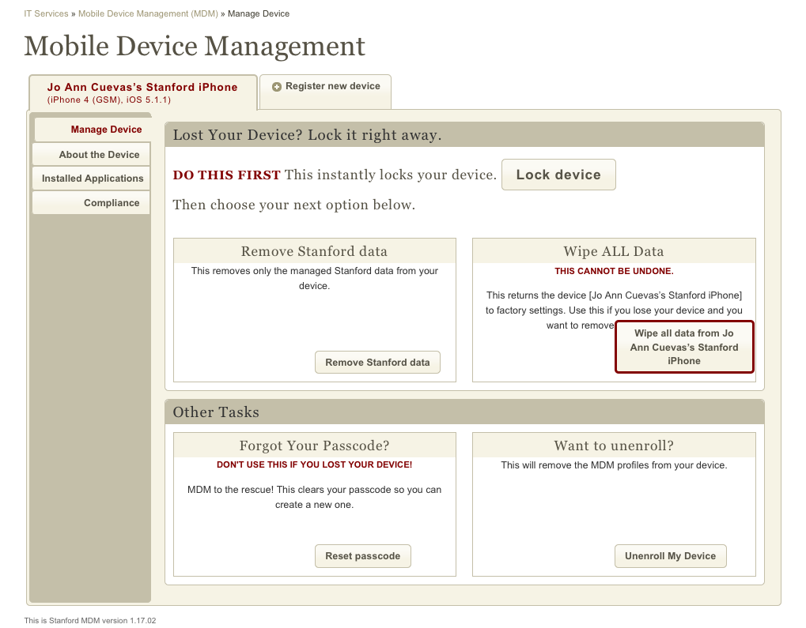
mdm.stanford.edu
Devices tabs
From the Manage Device interface, you can
Lock your device
Remove data
Reset your passcode, and
Unenroll from the MDM Service
New

Slide 12
mdm.stanford.edu
Check to see if your device is in Compliance for use with Stanford non-public data.

Slide 13
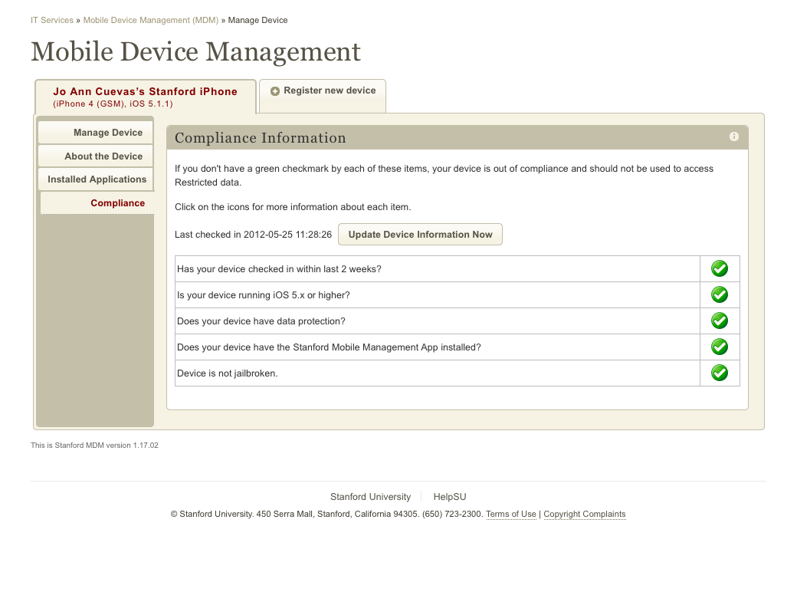
Compliance Tab
If any of the listed criteria is out of compliance, you will not see a green checkmark, but rather a warning symbol and be instructed on how to correct the issue

Slide 14
What is Jailbreak?
Jailbreaking disables (or circumvents) the manufacturer's security mechanisms and could allow malware to make undesirable changes to your device.
If your device is jailbroken, you are out of compliance for the Restricted Data profile and must fix the problem immediately.
To un-jailbreak your device, visit: https://itservices.stanford.edu/service/mobiledevice/management/managing/jailbreak

Slide 15
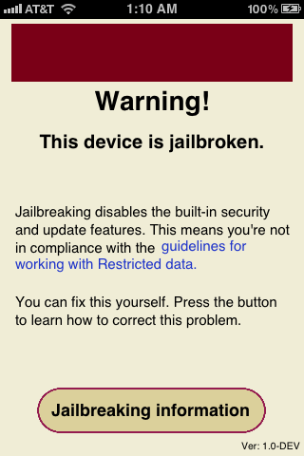
Jailbreak Detection
MDM helps alert you if your device has been jailbroken. When you tap on the MDM App, you will receive a warning.
Tap the Jailbreaking Information button to learn how to “unjailbreak” your device.

Slide 16
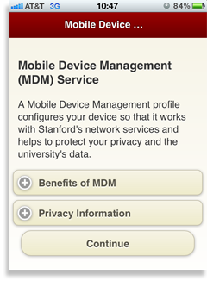
How to Install
On your iOS device (e.g., iPhone, iPad):
mdm.stanford.edu
Install!

Slide 17
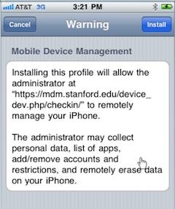
Our biggest hurdle: The Scary Warning Message (required by Apple)
Stanford cannot and will not access your personal data including:
Voicemail
Text messages
Photos
Angry Birds score
You can see everything we can see at mdm.stanford.edu.
Notes:
INSERT NOTES

Slide 18
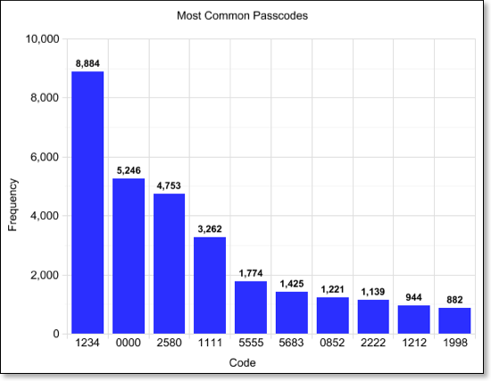
A Digression on Passcodes
A passcode is your first and best line of defense to protect your phone and your data, but choose wisely!
Daniel Amitay studied the most common passcodes. The top ten included: 1234, 0000, 1111, 5555, 5683 (LOVE), 2580, 0852, 2222, 1212, 1998
Of these, most are blocked by MDM policy except: 5683 (LOVE), 1998, 2580 and 0852 (vertical lines). Please choose something else.

Slide 19
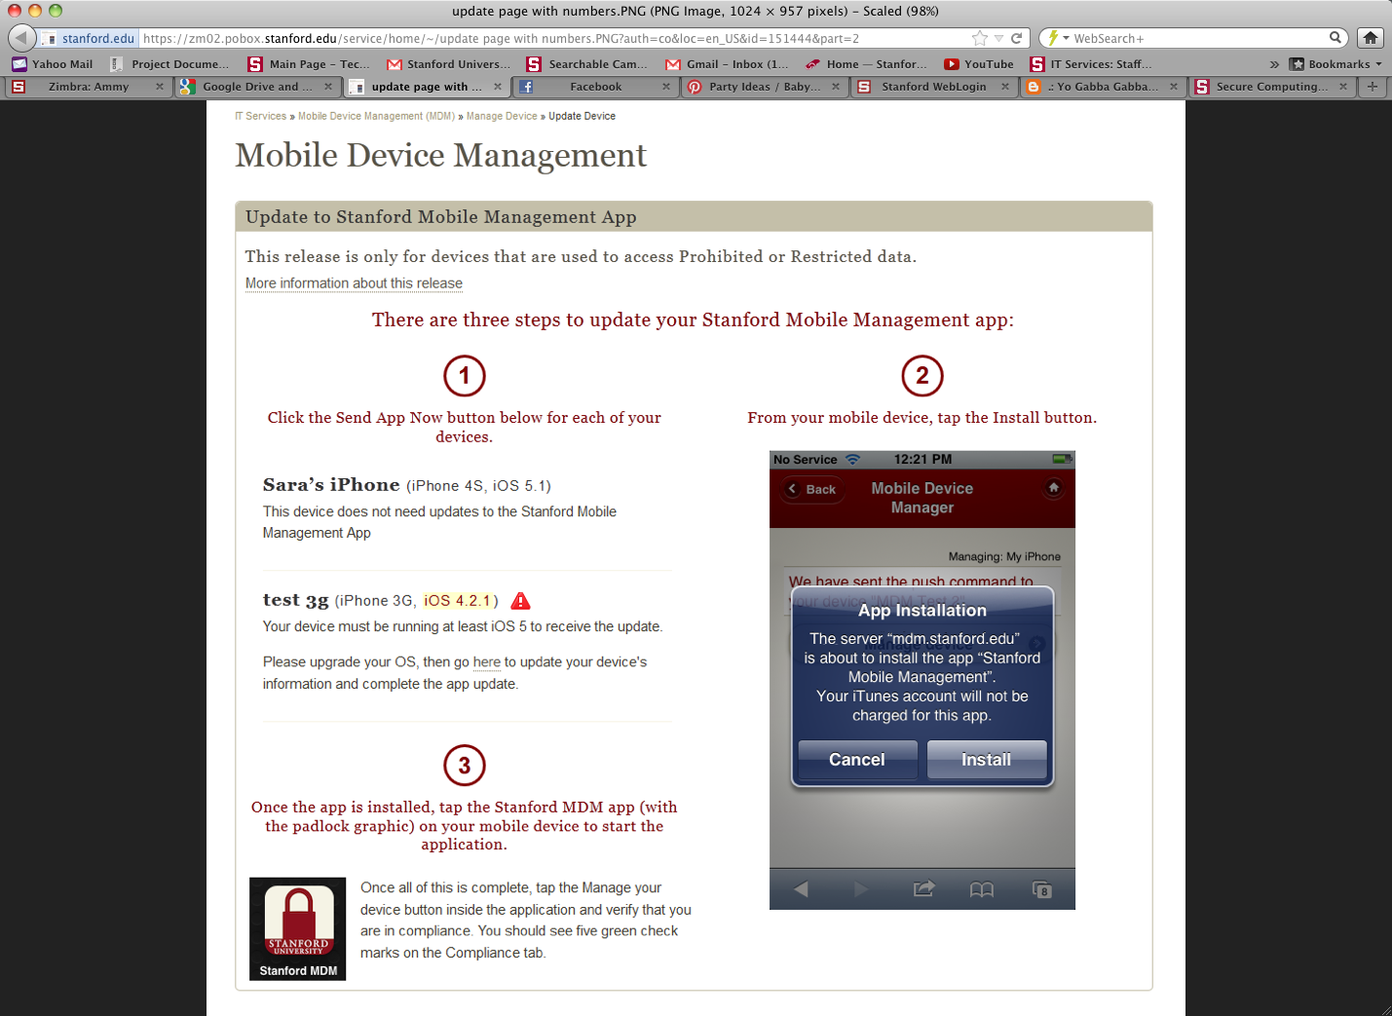
Managing MDM Over Time
Occasionally, MDM may need to be updated. When this happens, we’ll send you a link to the update page. It looks something like this.
Depending on the type of upgrade, you may have to complete the installation steps (Install, Install Now, Install, Done) again, but your MDM settings and preferences will be retained and replaced without having to answer questions again.

Slide 20
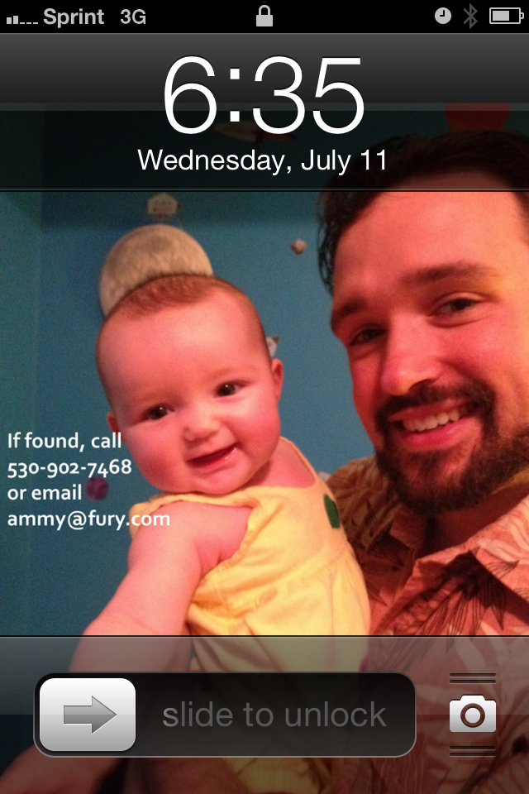
Use a screen saver or wallpaper with your contact information
There’s an app for that! Try If Found +, Return Me!, or Wallpaper Labeler.

Slide 21
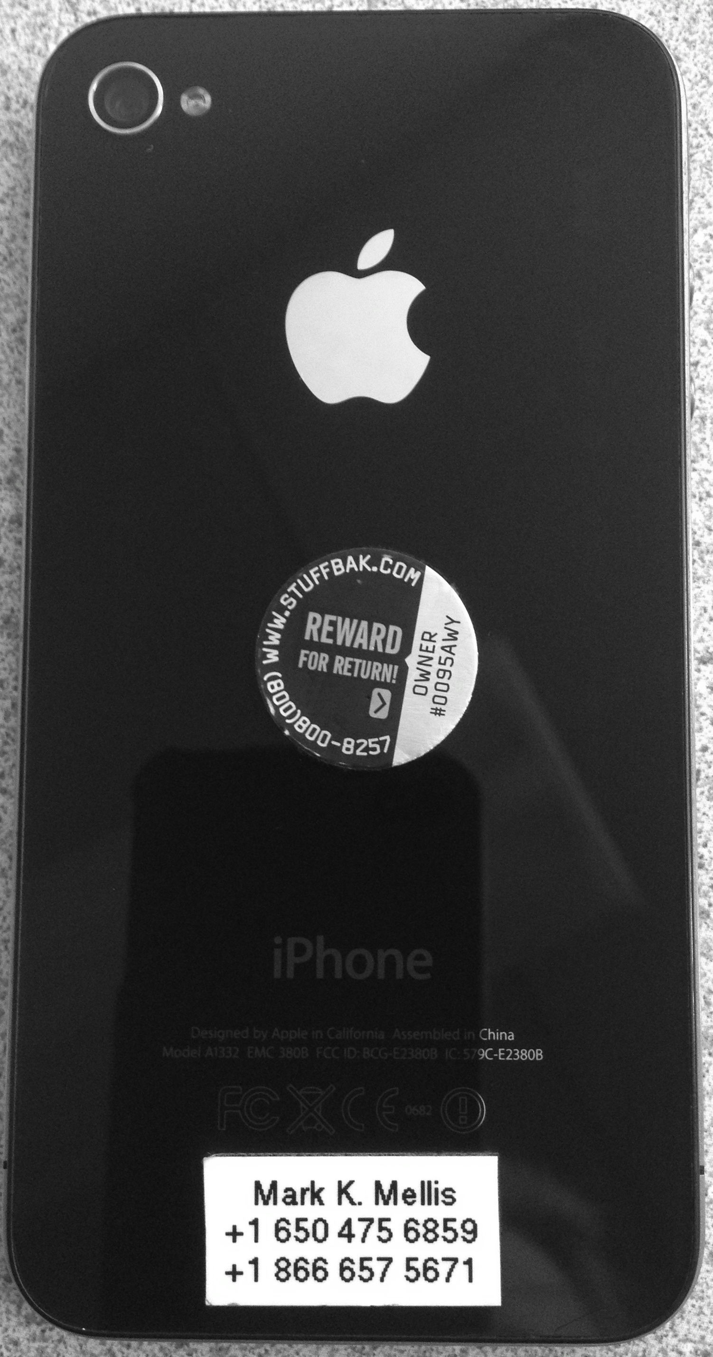
Use a label to put your contact info on your phone
Put it under your cover if you want to hide it

Slide 22
Back Up Your Phone
If you have an iPhone, this is easy with iTunes or iCloud.
If you lose your phone, a backup makes it easy to restore to a new device.
If your phone is stolen, a good backup means an easy choice to wipe the device and protect your data and your privacy.
Mobile Device Management

Slide 23
Update Your OS
Updates are released frequently to provide patches for new vulnerabilities.
Update by syncing with iTunes or over the air via iCloud.
The current version of iOS is 5.1.1.
Are you up to date? Go to Settings>General>About>Version to check.
Mobile Device Management

Slide 24
Use
Find
My iPhone
Find My iPhone does things only Apple can do.
- Find you phone on a map
- Have your phone light up with a message or play a sound
- Set a passcode remotely

Slide 25
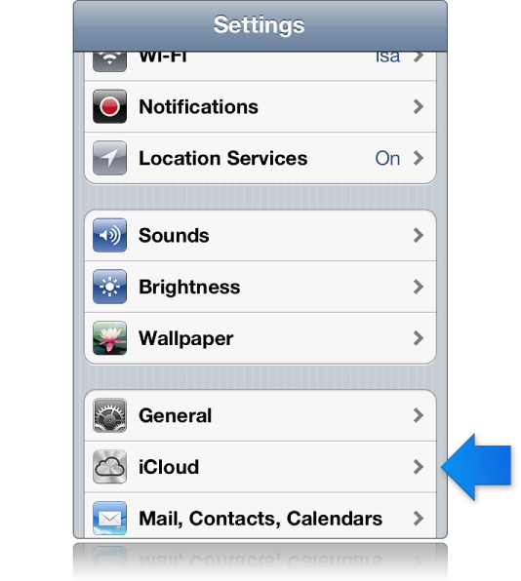
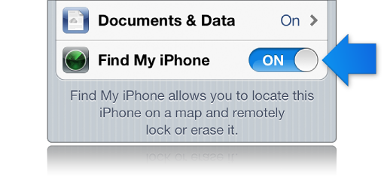
Set it up!
Go to Settings>iCloud>Find My iPhone and switch to ON.

Slide 26
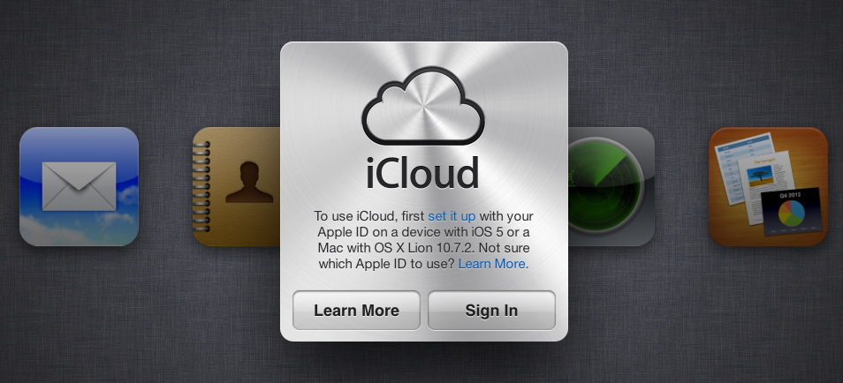
Go to iCloud.com to use Find My iPhone
The key is to set up iCloud and turn on Find My iPhone BEFORE you need it!

Slide 27
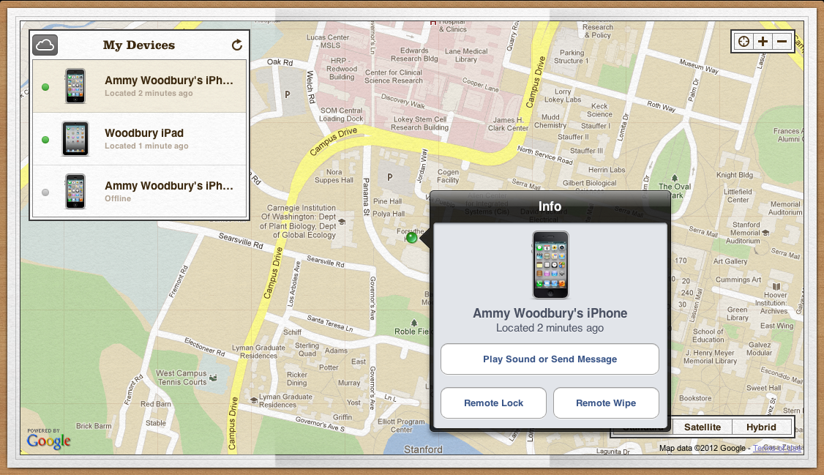
The key is to set up iCloud and turn on Find My iPhone BEFORE you need it!

Slide 28
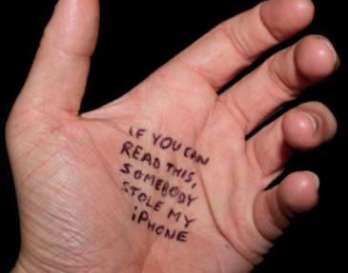
What if it’s really stolen?
Don’t panic.
Log into MDM and lock your device.
Change your SUNet ID password at accounts.stanford.edu.
Use icloud.com to locate it. Find out if you can track it down.
For Stanford-provided devices, call the Help Desk to report the loss.
Go to mdm.stanford.edu and execute a partial wipe to remove your Stanford data.
Decide when you’re ready to execute a full wipe via Find My iPhone.
Notes on Remote Wipe It only works if your phone 1. has battery, 2. is turned on, and 3. can get signal. If not, the remote wipe cannot be executed.

Slide 29
Need more information?
HelpSU.stanford.edu
Request Category:
Computers, Handhelds, Printers, Servers
Request Type:
Mobile Device Management
Or use this url: https://remedyweb.stanford.edu/helpsu/2.0/auth/helpsu-form?pcat=mdm
5-HELP
mobilemanagement.stanford.edu
Credit: iStockPhoto used with permission
Notes:
INSERT NOTES

